Slide 1

How do You Say My Name?

Slide 2
Dr. RAW-buh-lahth Dr. ROBBELOTH

Slide 3
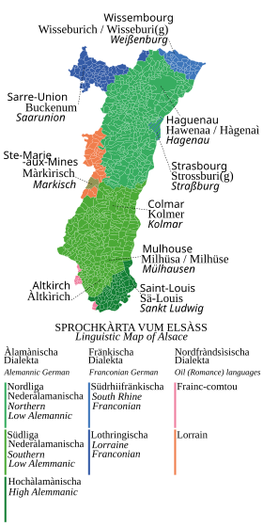
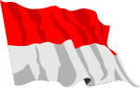
Family Name is Alsatian
Some might say Alsace-Lorraine
Basically eastern France & Germany
There is a flag and dialect unique to the area
1st Robbeloth, Jacob, came to US 1872 through Baltimore; naturalized 1892 in Dayton, Ohio
Great Grandmother was Fire Chief in Dayton
Last Robbeloth male in state
1st generation college student
Notes:
https://en.wikipedia.org/wiki/Alsatian_dialect
Octavia Robbeloth Michael C Robbeloth Thomas C Robbeloth Llyod T Robbeloth Robert Leo Robbeloth William Francis Robbeloth Jacob Robbeloth

Slide 4
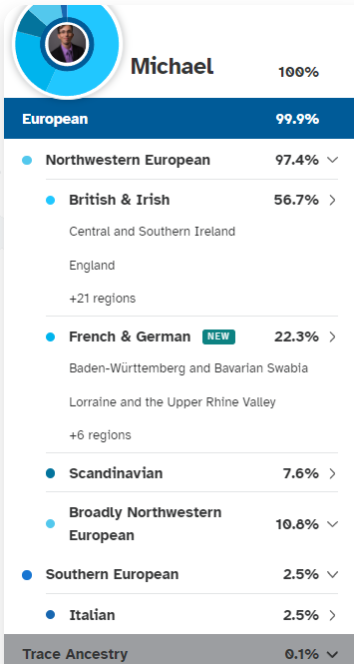
DNA tells a different story
Some French & German, but less than a quarter
Largest percentage is British & Irish (Mom’s side)
Scandinavian and Italian components were surprising

Slide 5
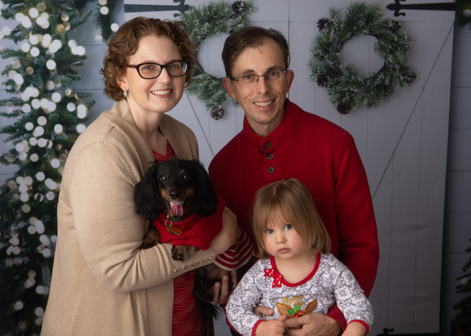
My Family THEN
Notes:
From a few years ago.

Slide 6
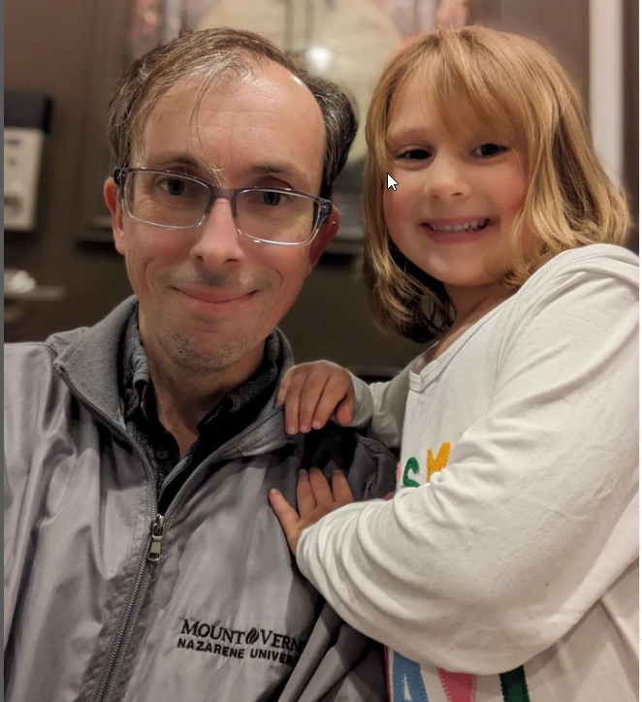
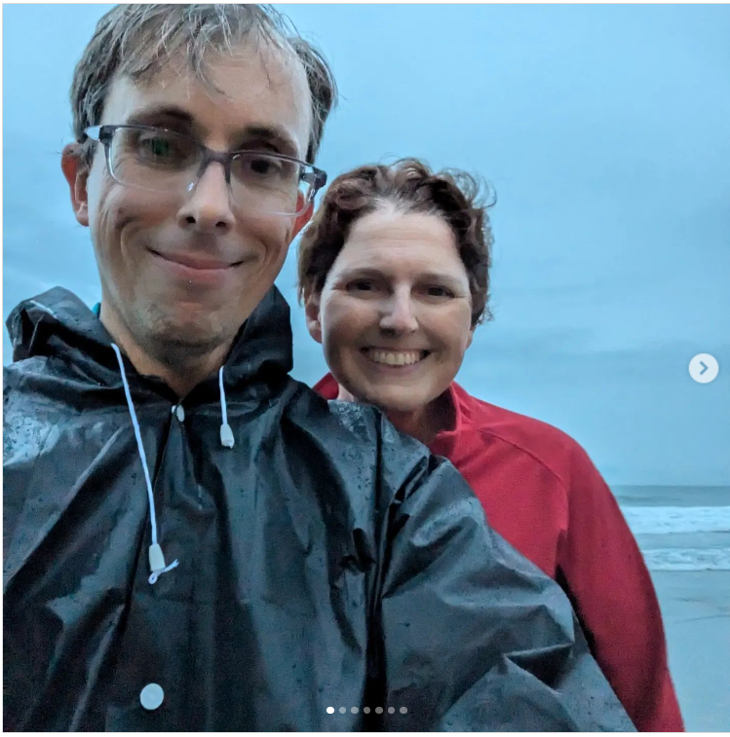
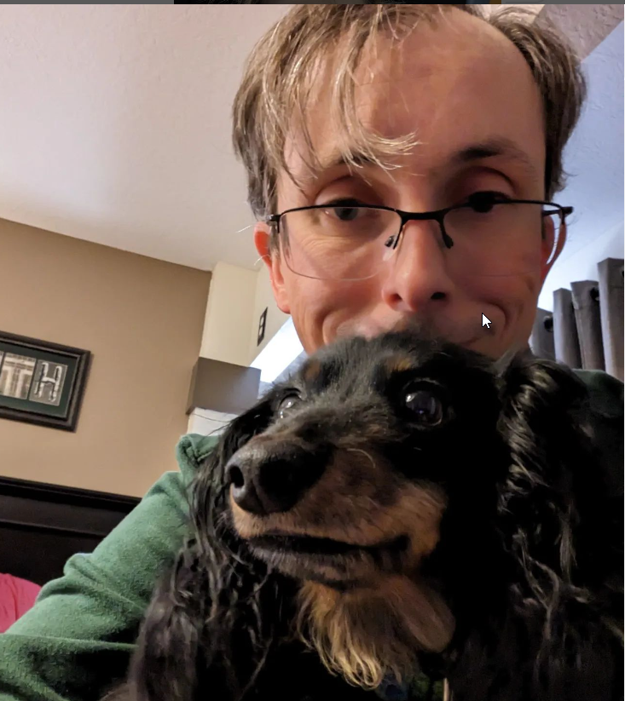
My Family NOW
Notes:
From a few years ago.

Slide 7

Education
Wright State Ph.D. CS & Engineering
University of Dayton (UD) MBA (finance)
Bowling Green State University (BGSU) (CS)
Wilmington College (CS & Math) Go Quakers!

Slide 8
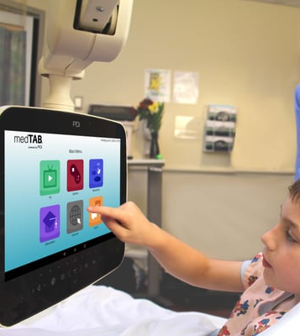
Industry (17.5 years)
Eastman Kodak (Embedded software engineer, Commerical inkjet printing systems)
Valco Cincinnati (Embedded software engineer sorting equipment)
Data Science Automation (Flapping wing Micro Air Vehicles, distributed Java simulation/modeling env)
PDi Communication Systems, Inc. (Embedded Software engineer and supervisor Android Smart TVs, AOSP)
DeVOPS Consultant (Client: PDi Communications systems, Inc.)

Slide 9
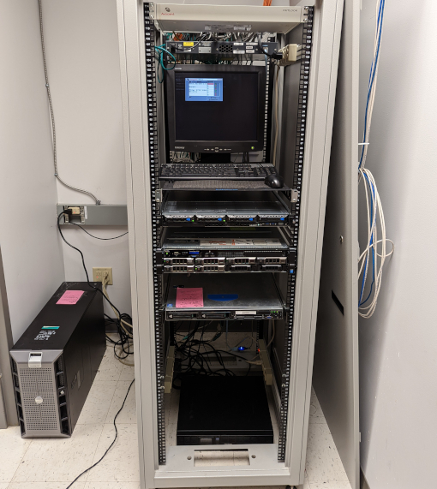
Academia
8+ years Total Experience
Senior Lecturer The Ohio State University (Spring 2025 – Present)
Associate Professor of Computer Science at Mount Vernon Nazarene University (MVNU) (2017- Fall 2024)
Part-Time Adjunct at Wilmington College (CS) and Sinclair Community College (Math), 2002-2011
Data Center ROOM AT MVNU (LLRC 035)

Slide 10
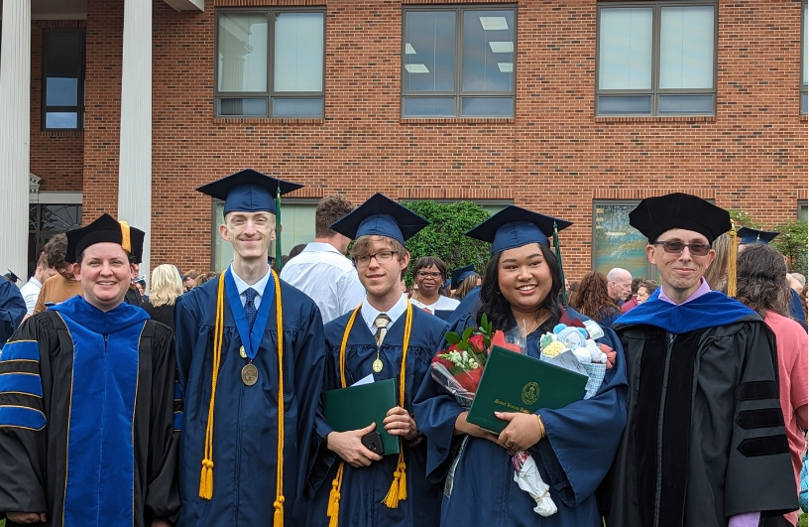
THANK YOU

